Slide 1


Slide 2
GA WDI Project Three SNPPR (pronounced Snipper)
Team CharTindIan
Ian Florentino, Satinder Grewal, Charles Park

Slide 3

Why SNPPR?
People want to quickly share images without having to format or upload each piece individually
Sending multiple pictures and web links at one time to friends is still a cumbersome and time-consuming process
Currently available picture-sharing methods are especially confusing and tedious for mature users
SNPPR makes it quicker for people to share images

Slide 4

What SNPPR Does
SNPPR is for all people who want to share images and links with their contacts quickly.
SNPPR is a web application that gives users a simple interface to share quick pictures and links.
Unlike current copy-and-paste methods, SNPPR gives a quick way to spread information with any and all contacts.

Slide 5

Current Competitive Landscape
Email – The Gold Standard; cumbersome
Text Messaging – Quick; not always reliable depending upon network
imgur/Flickr – Lots of images; but how flexible?
Gchat – Very quick; how to get images in one place?
bit.ly/TinyURL – Great for URL shortening; can they also provide targeted information?

Slide 6
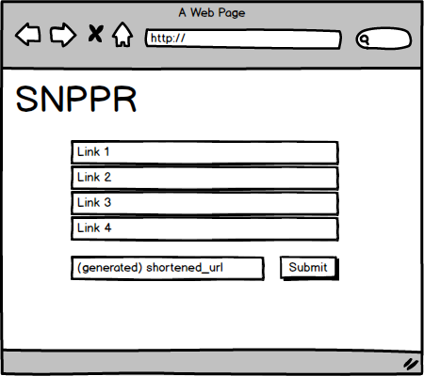
So what does SNPPR look like?

Slide 7
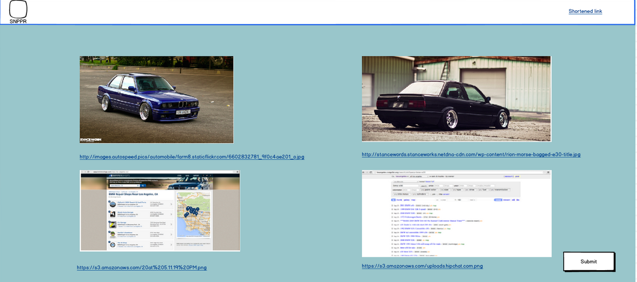
So what does SNPPR look like?

Slide 8
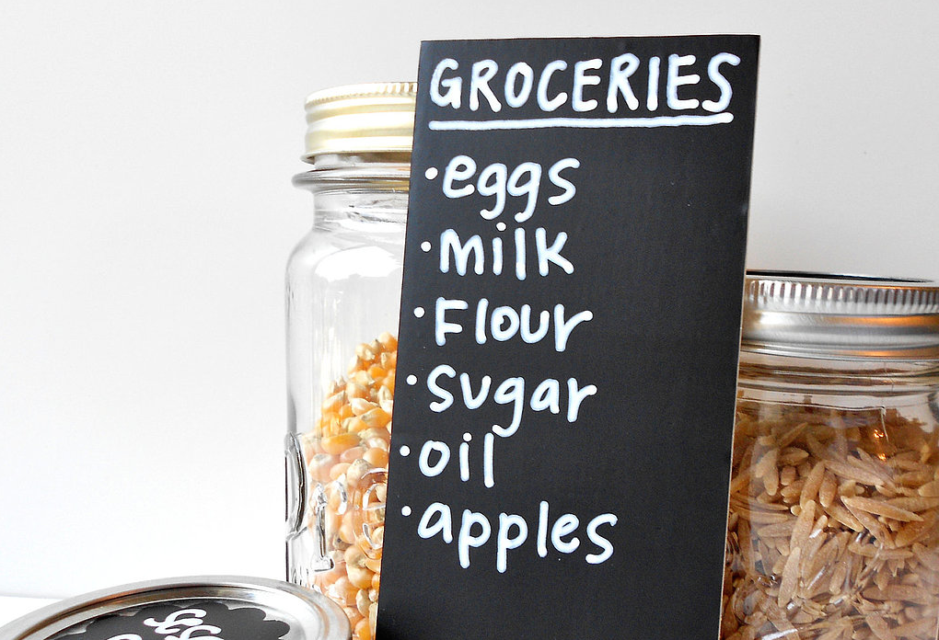
What’s IN, What’s OUT
IN: Image-sharing
IN: Link-sharing
out: Hosting and sharing offline images
Unresolved: Chrome Extension and additional browser support

Slide 9
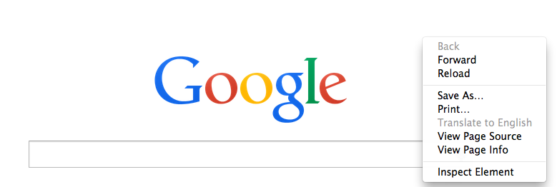

The X Factor
The Right-Click Chrome Extension!
Allows users to very quickly add links to SNPPR from any site
Add to SNPPR

Slide 10

Who Will Use SNPPR
People doing research
People confused by technology
SNPPR
People planning trips, events, purchases
Anyone who wants to share pictures and links with friends

Slide 11

How to target Both Audiences
Chrome extension for people on the go
Wireframe UI for people researching and collecting references (Desktop users)

Slide 12
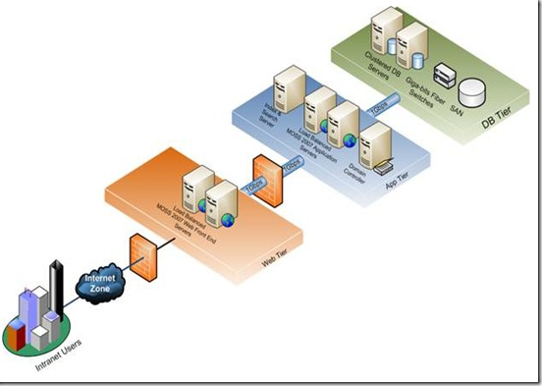
Technical solution
Technologies:
Ruby on Rails - API
JavaScript – Front End
- AngularJS/JQuery
Technologies:
- PostgreSQL – DB
RSpec - Testing
Chrome Extension

Slide 13

What Keeps Us Thinking
Diving into Chrome extensions
Slugging URL IDs
Communication between API and Front End
Scraping websites for metadata

Slide 14

Who’s Doing What
Ian Ruby on Rails Engineer, Map out Back End
Support Front End, QA
Satinder JavaScript Engineer, Map out Front End
Support Back End, QA
Charles Front End/Back End support, PivotalTracker Code Review, QA

Slide 15

Timeline
September 26 – Present This Pitch
October 3 – API complete
October 8 – Front End compatible with Back End API
October 10 – Chrome Extension Ready
October 10-14 - Styling
October 14 – Present SNPPR
* Testing takes place throughout Development

Slide 16

Trade-offs
On a scale of 1 to 10, where we envision the importance of each feature/category
10 - Time
4 - User Experience
7 - Chrome Extension
8 - Quality

Slide 17
The End

